Slide 1

Macroeconomics
Sixth Canadian Edition
Chapter 10
Credit Market Imperfections: Credit Frictions, Financial Crises, and Social Security
Copyright © 2021 Pearson Canada Inc.
Notes:
If this PowerPoint presentation contains mathematical equations, you may need to check that your computer has the following installed:
1) MathType Plugin
2) Math Player (free versions available)
3) NVDA Reader (free versions available)

Slide 2
Chapter 10 Topics
Credit Market Imperfections and Consumption.
Asymmetric Information and the Financial Crisis.
Limited Commitment and the Financial Crisis.
Social Security Programs.

Slide 3
Credit Market Imperfections and Consumption
Assume that lenders can lend at a lower interest rate than the one faced by borrowers.
The government borrows and lends at the interest rate that lenders face.
This implies that Ricardian equivalence does not hold, in general.

Slide 4
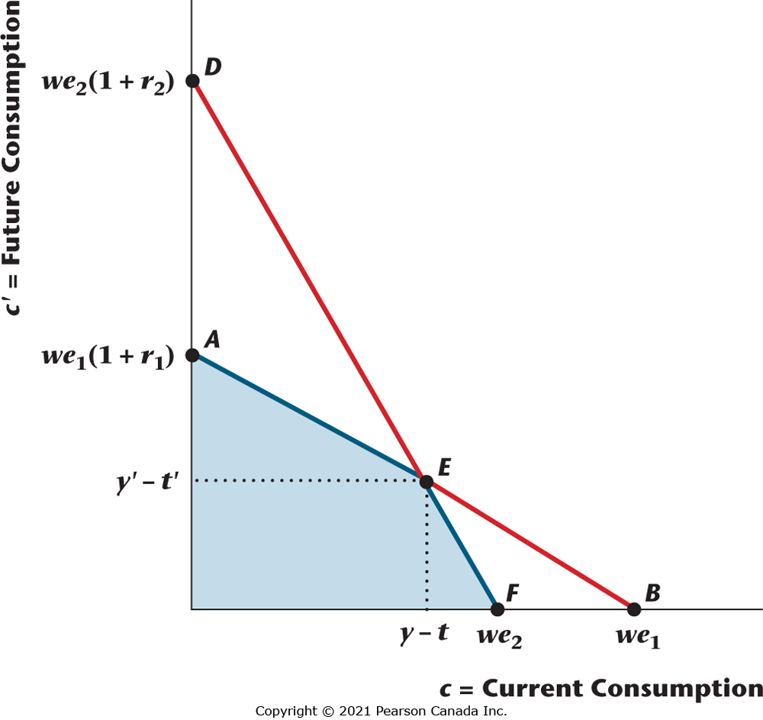
Figure 10.1 A Consumer Facing Different Lending and Borrowing Rates
When the borrowing rate of interest is higher than the lending rate, there is a kinked budget constraint, AEF, with the kink at the endowment point E.

Slide 5
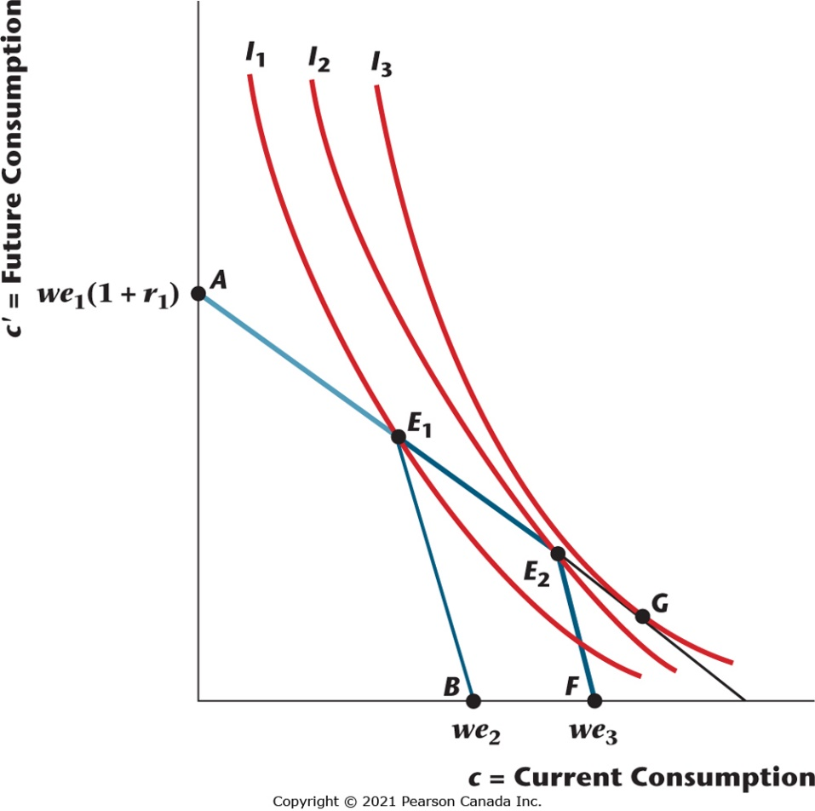
Figure 10.2 Effects of a Tax Cut for a Consumer with Different Borrowing and Lending Rates
The consumer receives a current tax cut, with a future increase in taxes, and this shifts the budget constraint from AE₁B to AE₂F. The consumer’s optimal consumption bundle shifts from E₁ to E₂, and the consumer will consume the entire tax cut.

Slide 6
Effects of a Tax Cut with Credit Market Imperfections
Suppose a consumer initially is credit constrained – that is he or she saves zero.
For such a consumer, the entire tax cut will be spent on current consumption.
This is very different from the case with no credit market imperfections, where the consumer will save the entire tax cut to pay higher future taxes.

Slide 7
Example: Credit Market Imperfections in General Equilibrium
Previous example looked at an individual consumer, in partial equilibrium (assuming the interest rate is given).
Useful to know what happens in general equilibrium when there are credit market imperfections.
For example, how does a tax cut affect market interest rates?

Slide 8
Example: General Equilibrium Model with Credit Market Imperfection, I
N consumers and a government.
N/2 lenders and N/2 borrowers.
2 periods, current period and future period.
Each lender: Endowment is y in the current period, 0 in the future period.
Each borrower: Endowment is 0 in the current period and y in the future period.
Lender cares only about consumption in the future period, borrower cares only about consumption in the current period.
Borrowing constraint

Slide 9

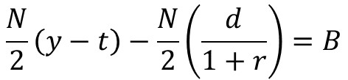
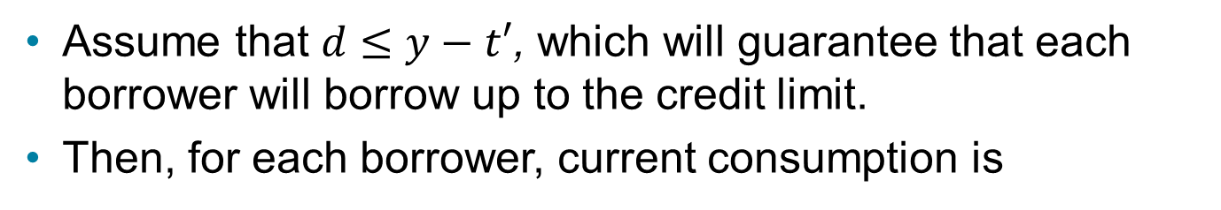
Equilibrium in the Model, Part I
Assume that $d≤y−t′$, which will guarantee that each borrower will borrow up to the credit limit.
Then, for each borrower, current consumption is
For each lender, $s=y−t,$ and future consumption is
Market-clearing in the credit market in the current period (total net saving equals government debt issued):

Slide 10
Equilibrium in the Model, Part II
The market-clearing condition then solves for the equilibrium real interest rate,
A decrease in d tightens borrowers’ borrowing constraints, reduces the demand for credit, and reduces the real interest rate.
An increase in government debt outstanding increases the real interest rate – acts like a government credit program, in that transfers increase in the current period, and taxes increase in the future period.
Increase in B effectively relaxes credit constraints.
Ricardian equivalence does not hold because of a credit market imperfection – increasing B increases economic welfare.

Slide 11
Credit Market Imperfections and Financial Crises
Two key credit market frictions: asymmetric information and limited commitment.
Asymmetric information: Would-be borrowers know more about their characteristics than do lenders.
Limited Commitment: Borrowers may choose to default – lender can overcome limited commitment with collateral.

Slide 12
Asymmetric Information in Credit Markets
Lending carried out through banks.
Deposit rate at banks is r₁, loan rate is r₂.
Fraction a of borrowers never defaults, fraction 1-a always defaults – bank cannot tell the good borrowers from the bad ones.
All good borrowers identical, borrow L.
Bad borrowers mimic the good ones.

Slide 13
Asymmetric Information – Deposit Rate and Loan Rate
Zero profits for the bank implies:
Therefore, there is a default premium (r₂ > r₁) when a < 1. The default premium increases as a decreases.

Slide 14
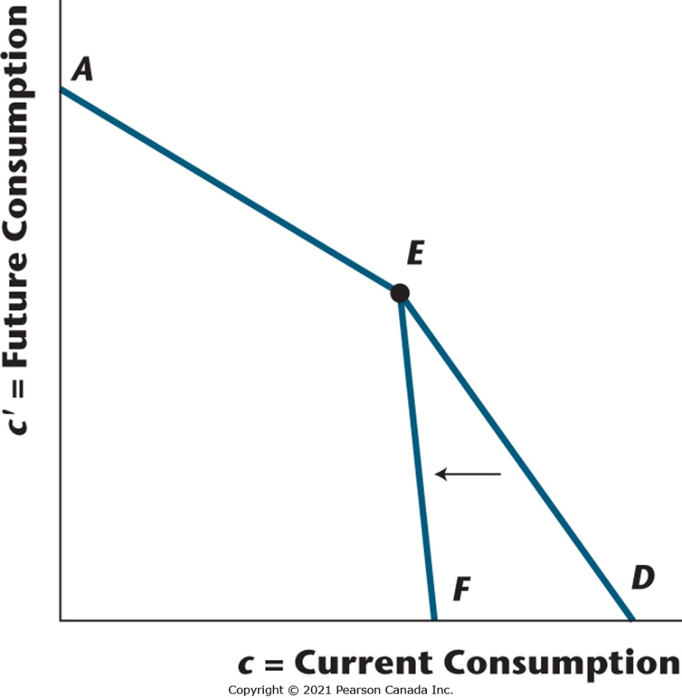
Figure 10.3 Asymmetric Information in the Credit Market and the Effect of a Decrease in Creditworthy Borrowers
Asymmetric information creates a kinked budget constraint AED, with the kink at the endowment point E. A decrease in the fraction of creditworthy borrowers in the population shifts the budget constraint to AEF.

Slide 15
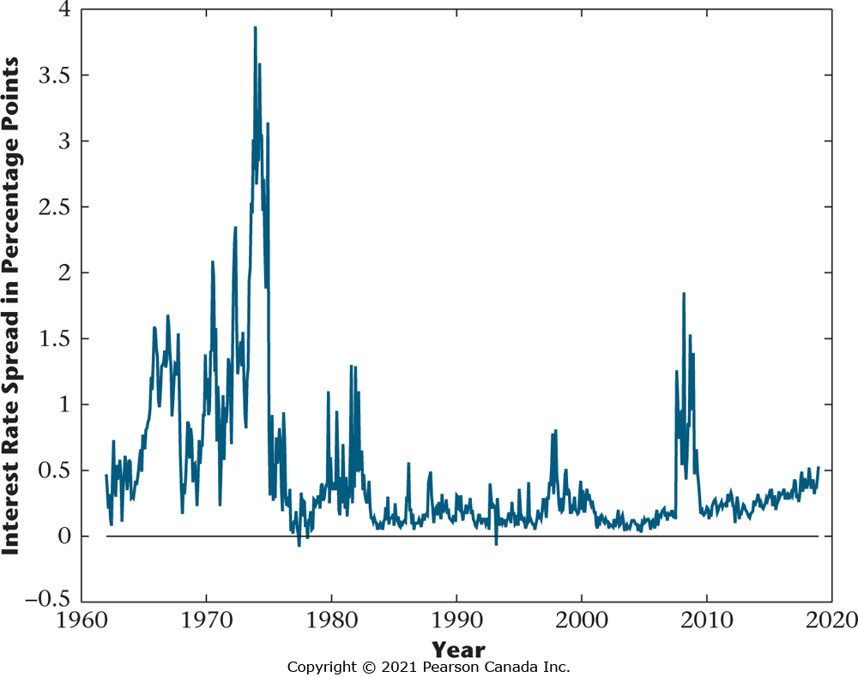
Figure 10.4 Interest Rate Spread
The figure depicts the difference between the interest rates on prime short-term corporate paper and short-term Government of Canada debt. This spread was high during the 1974–1975, 1981–1982, and 2008–2009 recessions, but not during the 1990–1992 recession.

Slide 16
Effect of a Decrease in the Fraction of Creditworthy Borrowers
Default premium increases – even good borrowers face higher loan rates.
Budget constraint shifts in.
Consumption falls for all borrowers.
Matches observations from the current financial crisis – increase in credit market uncertainty, reduction in lending, decrease in consumption expenditures.

Slide 17
Limited Commitment and Credit Markets
Borrowers need incentives not to default on their debts – these incentives typically provided by collateral requirements.
Examples: House is collateral for a mortgage loan, car is collateral for a car loan.

Slide 18
Example
H = quantity of housing owned by consumer.
p = price of housing.
Assume: Housing is illiquid – can’t be sold in the current period. However, it is possible to borrow against housing wealth, with a collateral constraint.

Slide 19
Consumer’s Constraints
Lifetime budget constraint:
Collateral constraint:
or

Slide 20
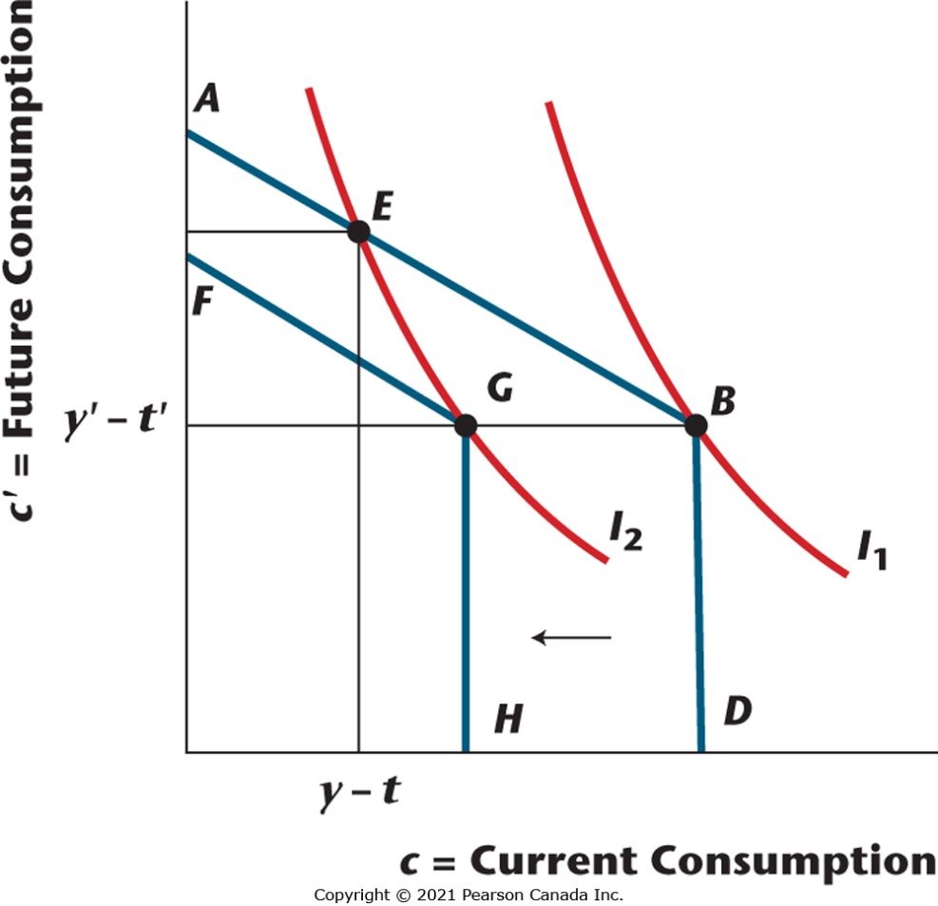
Figure 10.5 Limited Commitment with a Collateral Constraint
The consumer can borrow only with collateralizable wealth as security against the loan. As a result, the budget constraint is kinked. Initially the budget constraint is ABD and it shifts to FGH with a decrease in the price of collateral. For a constrained borrower, this causes no change in future consumption but current consumption drops by the same amount as the decrease in the value of collateral.

Slide 21
Pay-as-you-go Social Security (1 of 2)
Taxes on the working population pay for social security transfers to the retired each period.
Suppose two generations alive at each date, young and old.
The young pay social security taxes t, the old receive social security benefits b.

Slide 22
Population Growth
The population grows according to the following equation. Each period, there are N’ young and N old alive.

Slide 23
The Government Balances Its Budget
Total social security benefits must equal total taxes on the young.

Slide 24
Relationship Between Taxes for the Old and Benefits for the Young

Slide 25
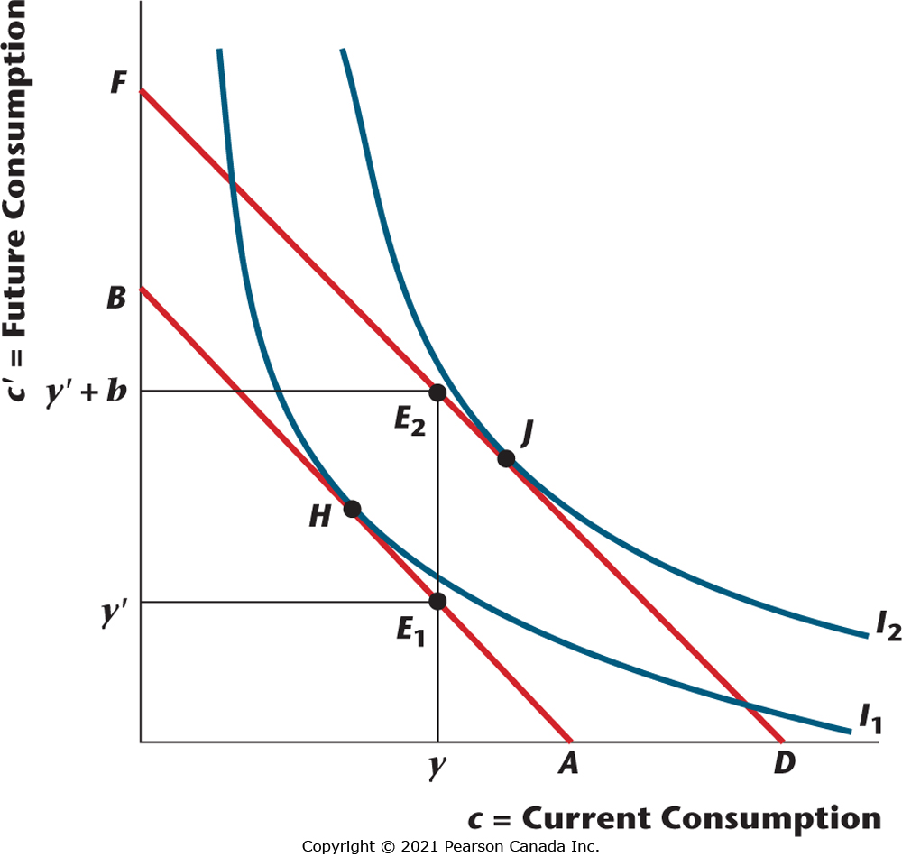
Figure 10.8 Pay-as-You-Go Social Security for Consumers Who Are Old in Period T
In the period when social security is introduced, the old receive a social security benefit. The budget constraint of an old consumer shifts from AB to DF, and he or she is clearly better off.

Slide 26
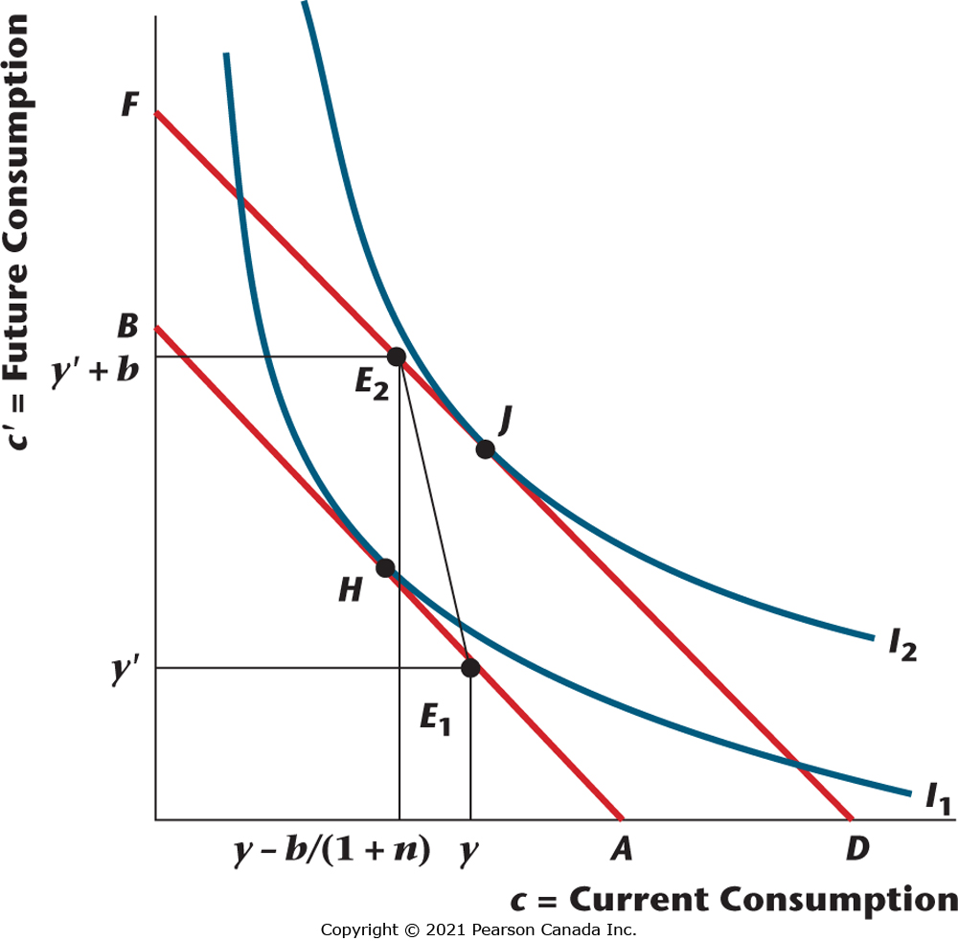
Figure 10.9 Pay-as-You-Go Social Security for Consumers Born in Period T and Later
If n > r, the budget constraint shifts out from AB to DF, and the consumer is better off.

Slide 27
Pay-as-you-go Social Security (2 of 2)
Pay-as-you-go is beneficial only if the population growth rate exceeds the real interest rate.
The interpretation is that the population growth rate is the implied rate of return for an individual from the social security system, so social security is only worthwhile if the return exceeds what could be obtained in private credit markets.

Slide 28
Fully Funded Social Security
Essentially a mandated savings program where assets are acquired by the young, with these assets sold in retirement.

Slide 29
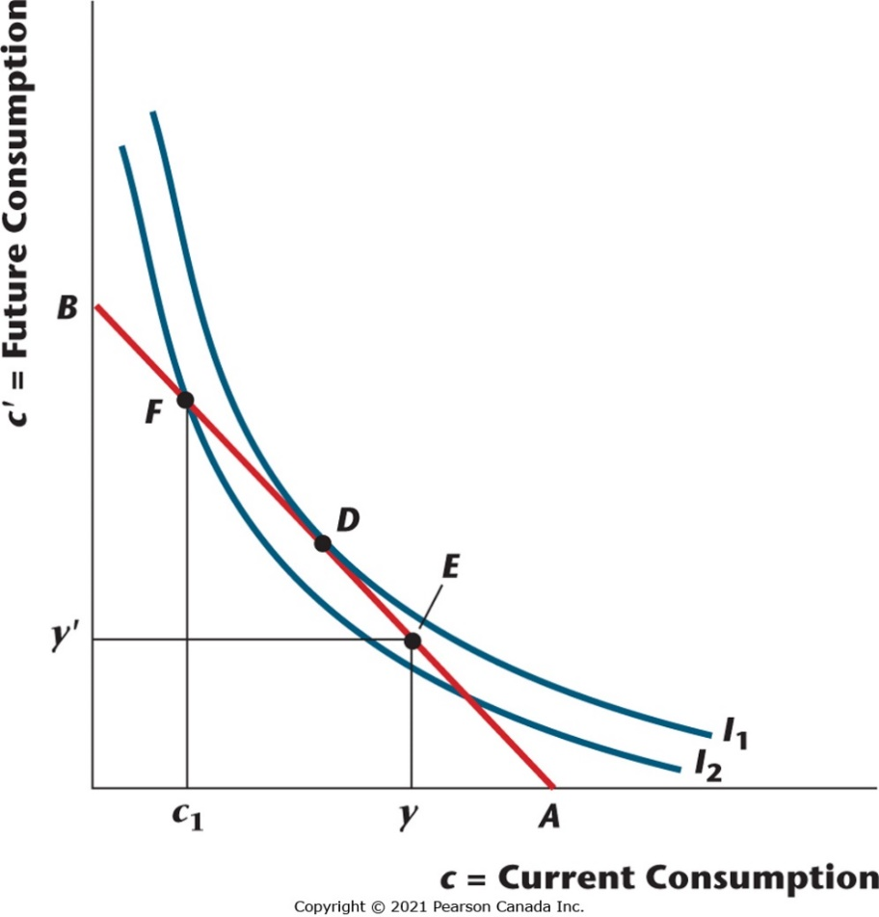
Figure 10.10 Fully Funded Social Security When Mandated Retirement Saving is Binding
With binding mandated retirement saving, the consumer must choose point F rather than D and is, therefore, worse off.

